Slide 1
Natural Language Processing
- Formal Language -
(formal) Language
(formal) Grammar

Slide 2
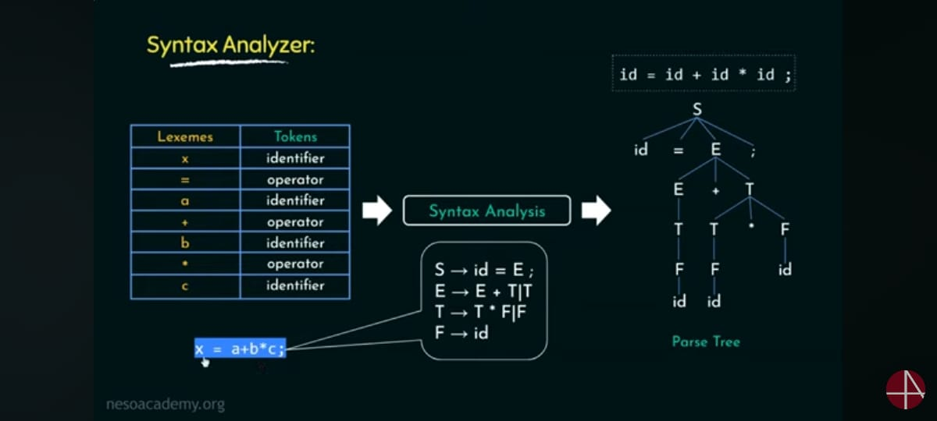

Slide 3
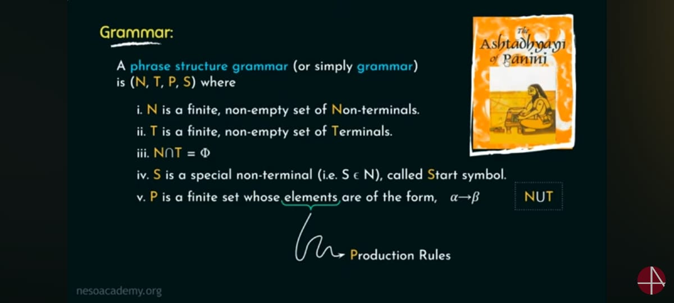

Slide 4
Formal Language
A formal language L is a set of finite-length words (or "strings") over some finite alphabet A. ε is the empty word.
Example:
A = {a, b, c}
L₁ = {ab, c}

Slide 5
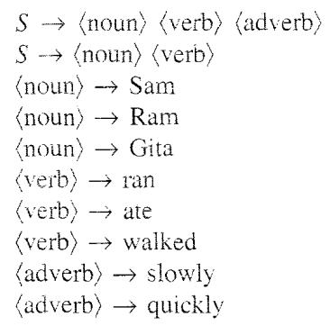

Slide 6
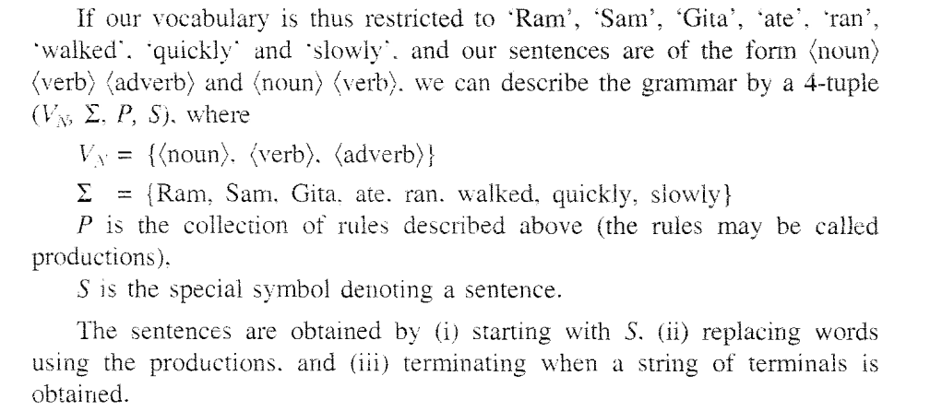

Slide 7
Formal Languages - Examples
Some examples of formal languages:
the set of all words over {a, b},
the set { a^{n} | n is a prime number },
the set of syntactically correct programs in some programming language, or
the set of inputs upon which a certain Turing machine halts.

Slide 8
Several operations can be used to produce new languages from given ones. Suppose L1 and L2 are languages over some common alphabet.
The concatenation L1L2 consists of all strings of the form vw where v is a string from L1 and w is a string from L2.
The intersection of L1 and L2 consists of all strings which are contained in L1 and also in L2.
The union of L1 and L2 consists of all strings which are contained in L1 or in L2.
The complement of the language L1 consists of all strings over the alphabet which are not contained in L1.
The Kleene star L1* consists of all strings which can be written in the form w1w2...wn with strings wi in L1 and n ≥ 0. Note that this includes the empty string ε because n = 0 is allowed.

Slide 9
A formal language can be specified in a great variety of ways, such as:
Strings produced by some formal grammar (see Chomsky hierarchy)
Strings produced by a regular expression
Strings accepted by some automaton, such as a Turing machine or finite state automaton
From a set of related YES/NO questions those ones for which the answer is YES, see decision problem

Slide 10
If we select a string w such that w∈L, and w=xyz. Which of the following portions cannot be an empty string?
a) x
b) y
c) z
d) all of the mentioned

Slide 11
Let w= xyz and y refers to the middle portion and |y|>0.What do we call the process of repeating y 0 or more times before checking that they still belong to the language L or not?
a) Generating
b) Pumping
c) Producing
d) None of the mentioned

Slide 12
Formal Grammar - Definition
A formal grammar G = (N, Σ, P, S) consists of:
A finite set N of nonterminal symbols.
A finite set Σ of terminal symbols that is disjoint from N.
A finite set P of production rules where a rule is of the form
    string in (Σ U N)* -> string in (Σ U N)*
  (where * is the Kleene star and U is set union)
  the left-hand side of a rule must contain at least one nonterminal symbol.
A symbol S in N that is indicated as the start symbol.

Slide 13
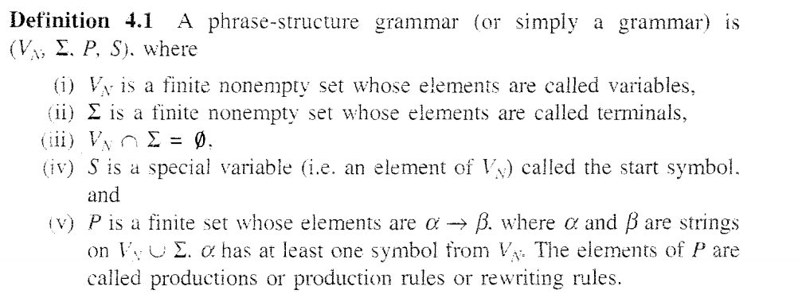

Slide 14
A regular language over an alphabet a is one that can be obtained from
a) union
b) concatenation
c) kleene
d) All of the mentioned

Slide 15
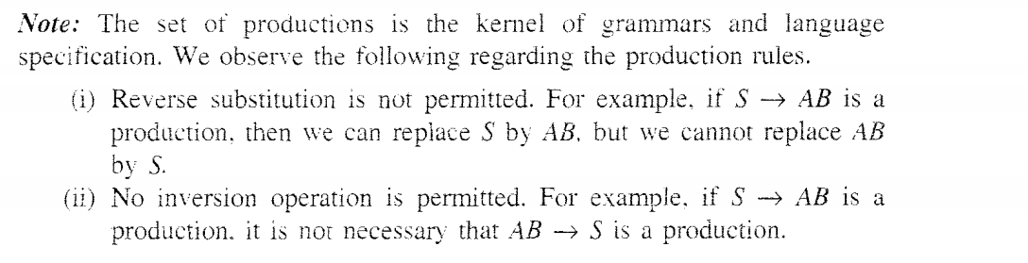

Slide 16
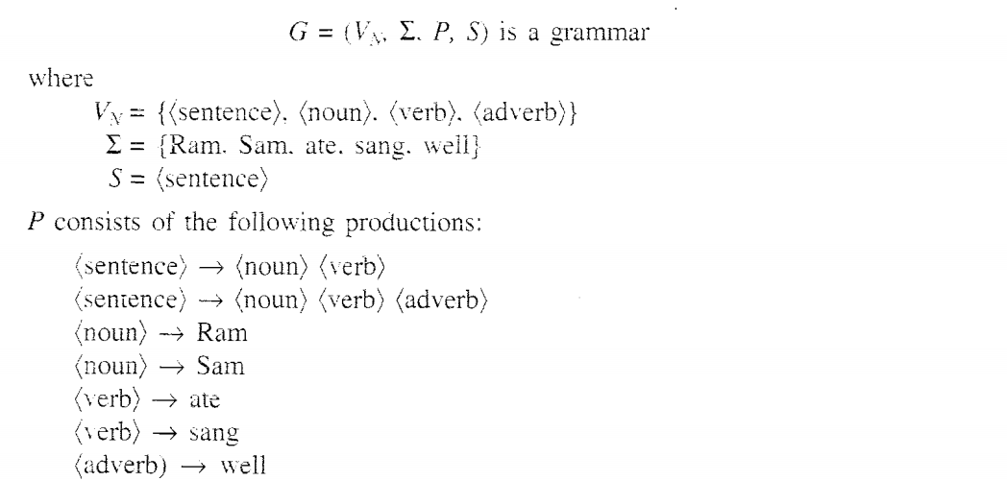

Slide 17
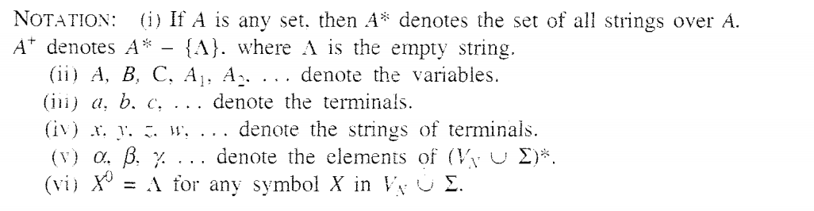

Slide 18
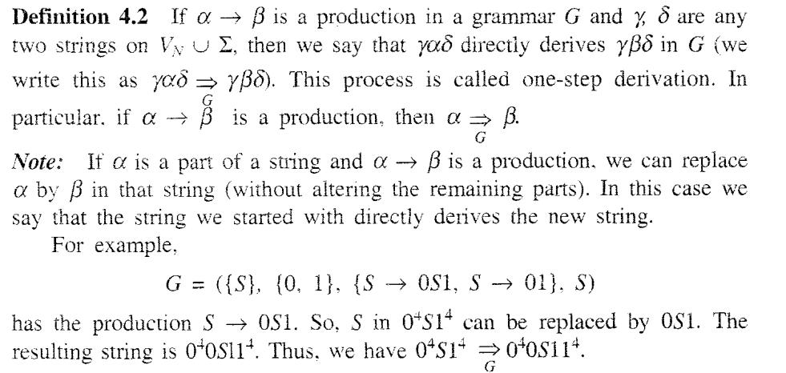

Slide 19
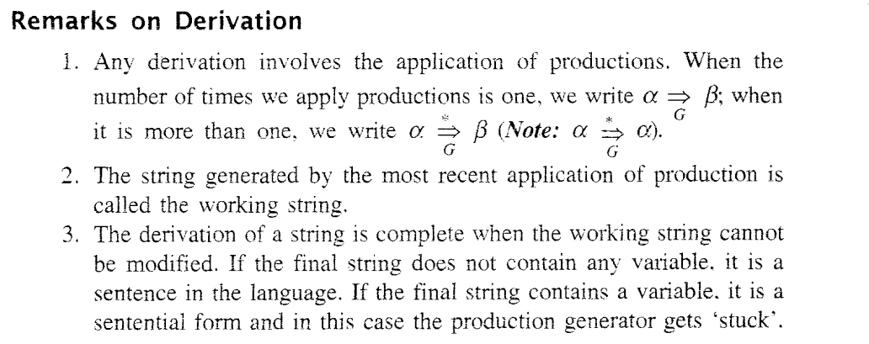

Slide 20
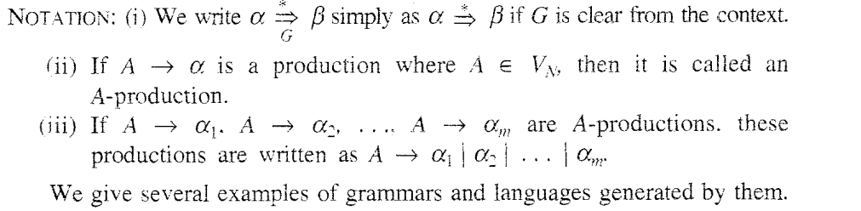

Slide 21
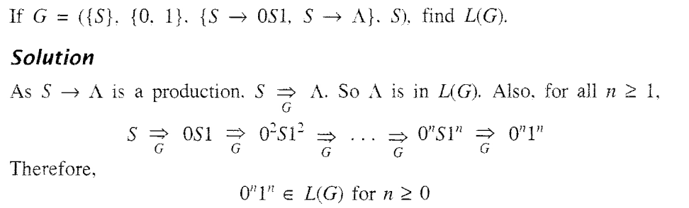

Slide 22
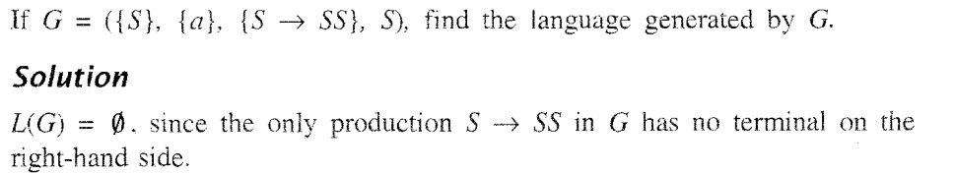

Slide 23
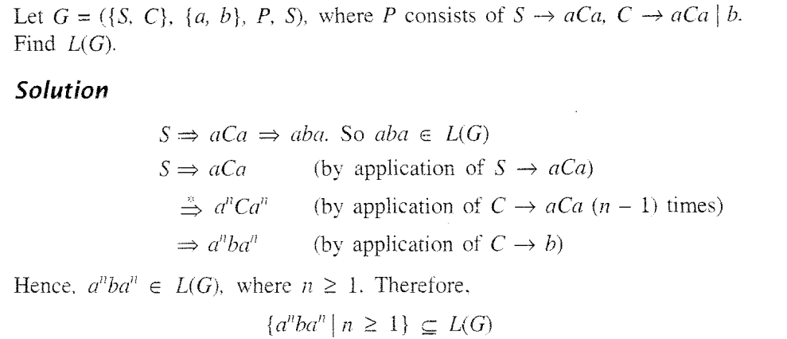

Slide 24
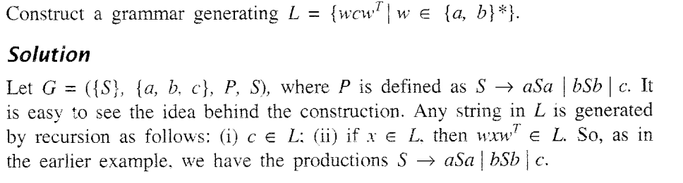

Slide 25
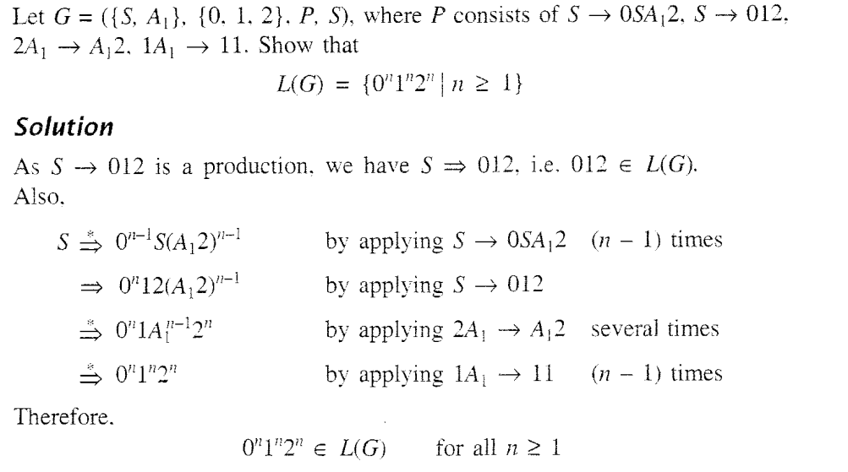

Slide 27
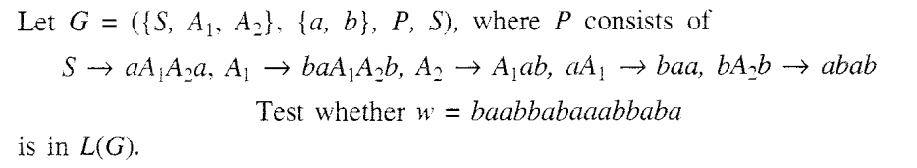

Slide 28
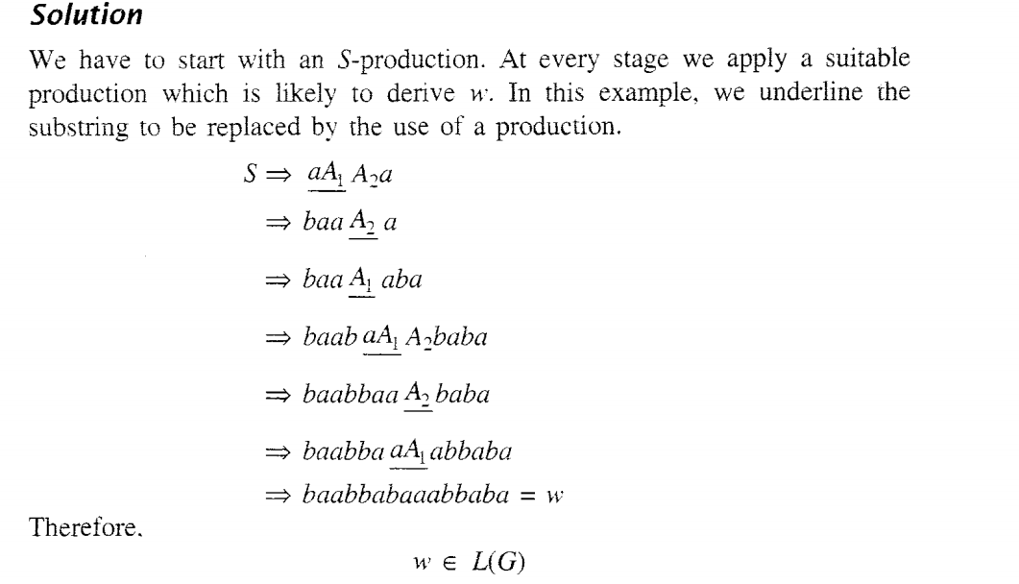

Slide 29
Answer in accordance to the third and last statement in pumping lemma:
For all _______ xy^{i}z ∈L
a) i>0
b) i<0
c) i<=0
d) i>=0

Slide 30
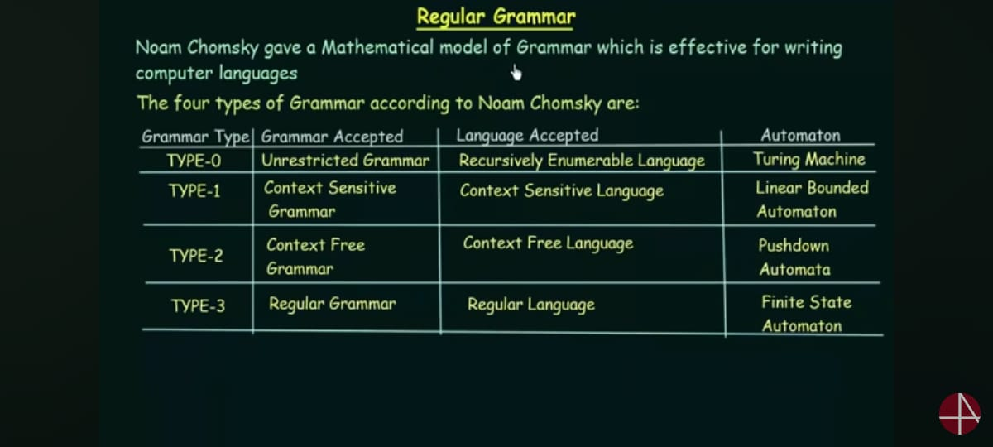

Slide 31
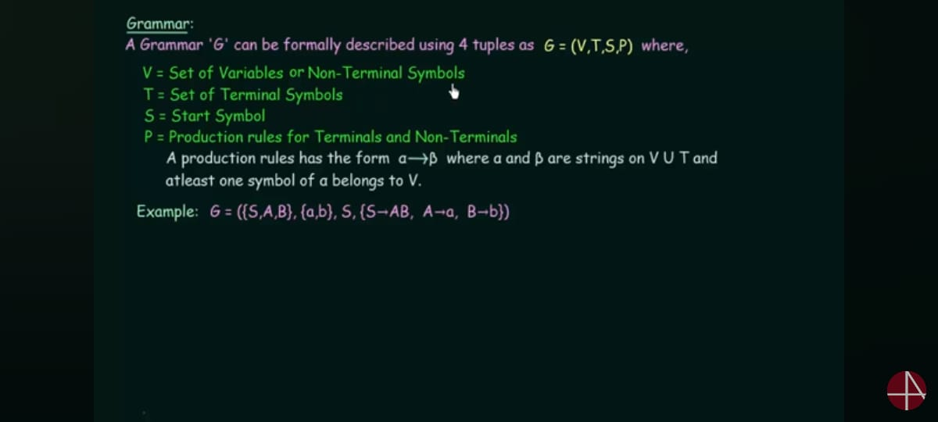

Slide 32
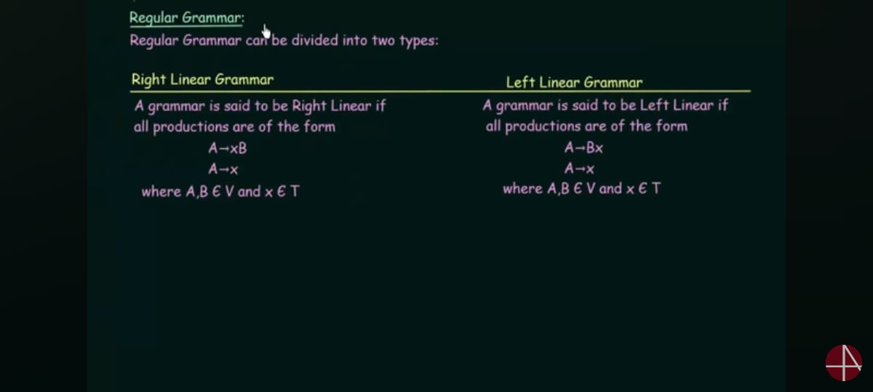

Slide 33
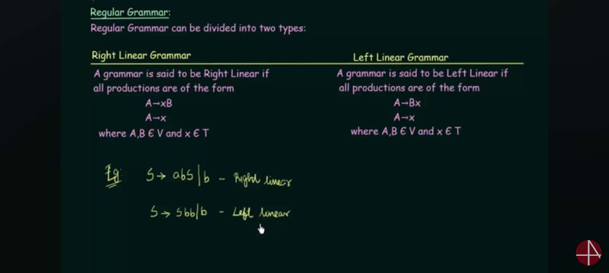

Slide 34
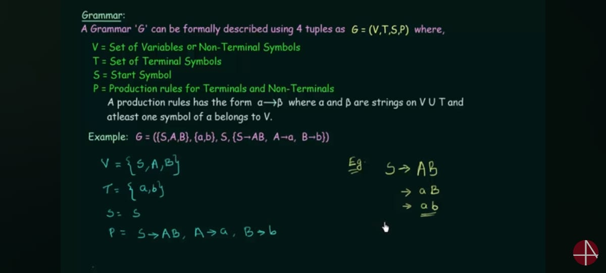

Slide 35
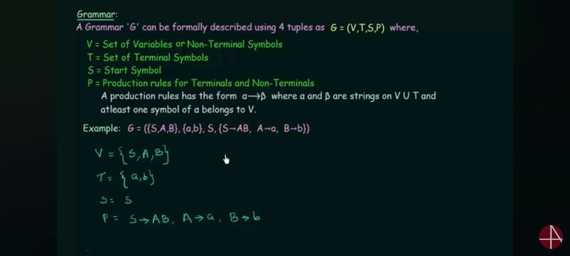

Slide 36
Closure properties of regular sets
Property 1. The union of two regular set is regular.
Proof −
Let us take two regular expressions
RE₁ = a(aa)* and RE₂ = (aa)*
So, L₁ = {a, aaa, aaaaa,.....} (Strings of odd length excluding Null)
and L₂ ={ ε, aa, aaaa, aaaaaa,.......} (Strings of even length including Null)
L₁ ∪ L₂ = { ε, a, aa, aaa, aaaa, aaaaa, aaaaaa,.......}
(Strings of all possible lengths including Null)
RE (L₁ ∪ L₂) = a* (which is a regular expression itself)
Hence, proved.

Slide 37
Closure properties of regular sets
Property 2. The intersection of two regular set is regular.
Proof −
Let us take two regular expressions
RE₁ = a(a*) and RE₂ = (aa)*
So, L₁ = { a,aa, aaa, aaaa, ....} (Strings of all possible lengths excluding Null)
L₂ = { ε, aa, aaaa, aaaaaa,.......} (Strings of even length including Null)
L₁ ∩ L₂ = { aa, aaaa, aaaaaa,.......} (Strings of even length excluding Null)
RE (L₁ ∩ L₂) = aa(aa)* which is a regular expression itself.
Hence, proved.

Slide 38
Closure properties of regular sets
Property 3. The complement of a regular set is regular.
Proof −
Let us take a regular expression −
RE = (aa)*
So, L = {ε, aa, aaaa, aaaaaa, .......} (Strings of even length including Null)
Complement of L is all the strings that is not in L.
So, L’ = {a, aaa, aaaaa, .....} (Strings of odd length excluding Null)
RE (L’) = a(aa)* which is a regular expression itself.
Hence, proved.

Slide 39
Closure properties of regular sets
Property 4. The difference of two regular set is regular.
Proof −
Let us take two regular expressions −
RE₁ = a (a*) and RE₂ = (aa)*
So, L₁ = {a, aa, aaa, aaaa, ....} (Strings of all possible lengths excluding Null)
L₂ = { ε, aa, aaaa, aaaaaa,.......} (Strings of even length including Null)
L₁ – L₂ = {a, aaa, aaaaa, aaaaaaa, ....}
(Strings of all odd lengths excluding Null)
RE (L₁ – L₂) = a (aa)* which is a regular expression.

Slide 40
Closure properties of regular sets
Property 5. The reversal of a regular set is regular.
Proof −
We have to prove L^{R} is also regular if L is a regular set.
Let, L = {01, 10, 11, 10}
RE (L) = 01 + 10 + 11 + 10
L^{R} = {10, 01, 11, 01}
RE (L^{R}) = 01 + 10 + 11 + 10 which is regular
Hence, proved.
Property 6. The closure of a regular set is regular.
Proof −
If L = {a, aaa, aaaaa, .......} (Strings of odd length excluding Null)
i.e., RE (L) = a (aa)*
L* = {a, aa, aaa, aaaa , aaaaa,……………} (Strings of all lengths excluding Null)
RE (L*) = a (a)*
Hence, proved.

Slide 41
Closure properties of regular sets
Property 7. The concatenation of two regular sets is regular.
Proof −
Let RE₁ = (0+1)*0 and RE₂ = 01(0+1)*
Here, L₁ = {0, 00, 10, 000, 010, ......} (Set of strings ending in 0)
and L₂ = {01, 010,011,.....} (Set of strings beginning with 01)
Then, L₁ L₂ = {001,0010,0011,0001,00010,00011,1001,10010,.............}
Set of strings containing 001 as a substring which can be represented by an RE − (0 + 1)*001(0 + 1)*

Slide 42
If L1, L2 are regular and op(L1, L2) is also regular, then L1 and L2 are said to be ____________ under an operation op.
a) open
b) closed
c) decidable
d) none of the mentioned

Slide 43
If L1′ and L2′ are regular languages, then L1.L2 will be
a) regular
b) non regular
c) may be regular
d) none of the mentioned

Slide 44
Language of a Formal Grammar
The language of a formal grammar G = (N, Σ, P, S), denoted as L(G), is defined as all those strings over Σ that can be generated by starting with the start symbol S and then applying the production rules in P until no more nonterminal symbols are present.

Slide 45
Language of a Formal Grammar
Example
Consider, for example, the grammar G with N = {S, B}, Σ = {a, b, c}, P consisting of the following production rules
  1. S -> aBSc
  2. S -> abc
  3. Ba -> aB
  4. Bb -> bb
This grammar defines the language {a^{n}b^{n}c^{n} | n>0}

Slide 46
Which of the expression is appropriate?
For production p: a->b where a∈V and b∈_______
a) V
b) S
c) (V+∑)*
d) V+ ∑

Slide 47
CSE322
The Chomsky Hierarchy
Lecture #16

Slide 48
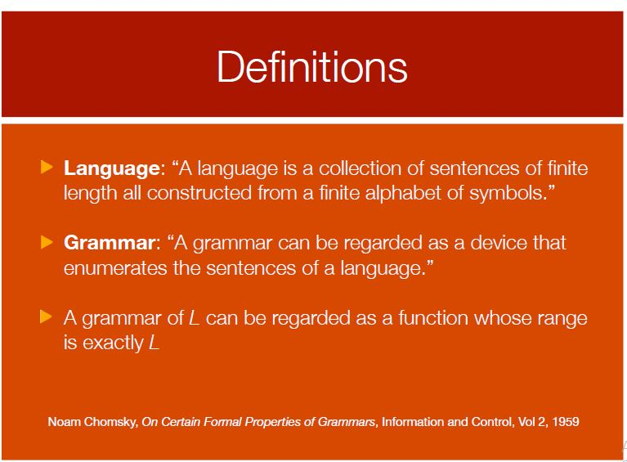

Slide 49
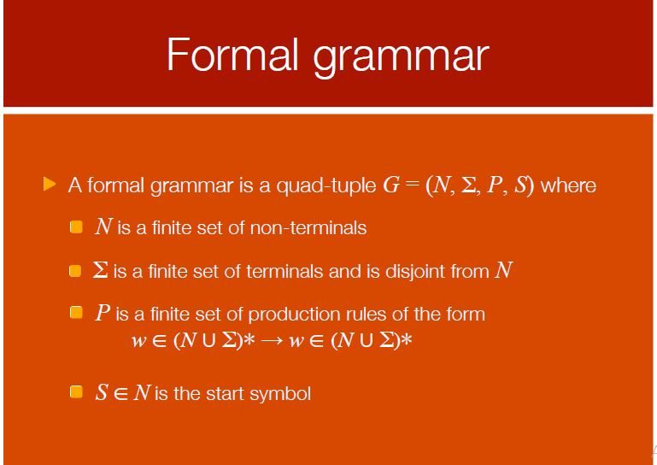


Slide 50
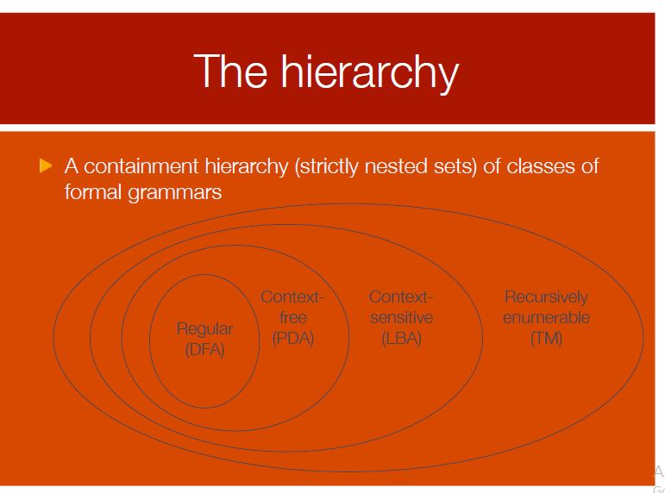

Slide 51
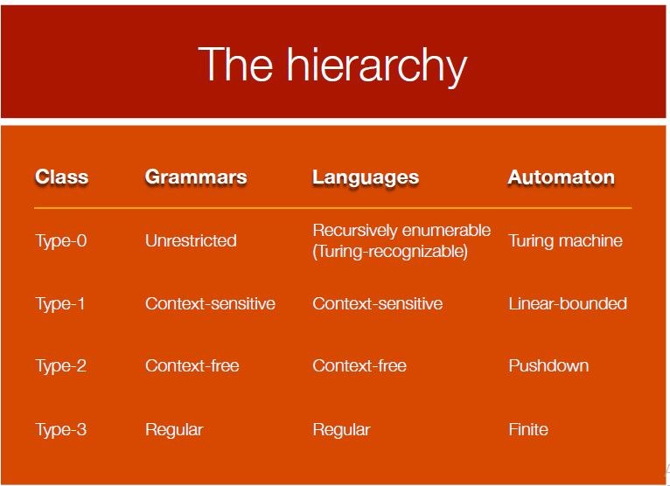

Slide 52
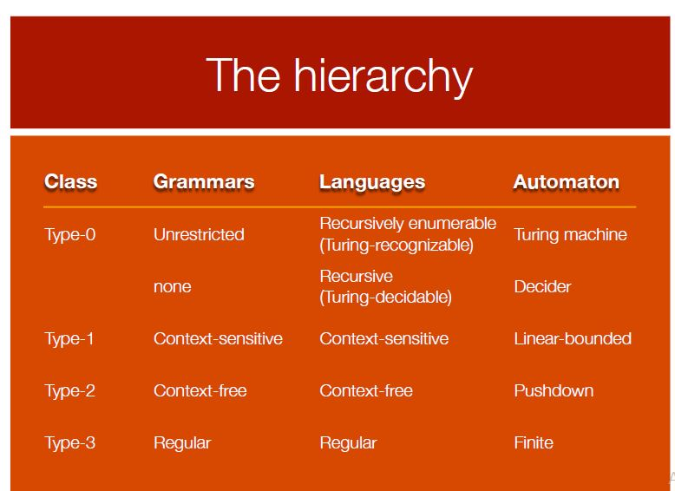

Slide 53
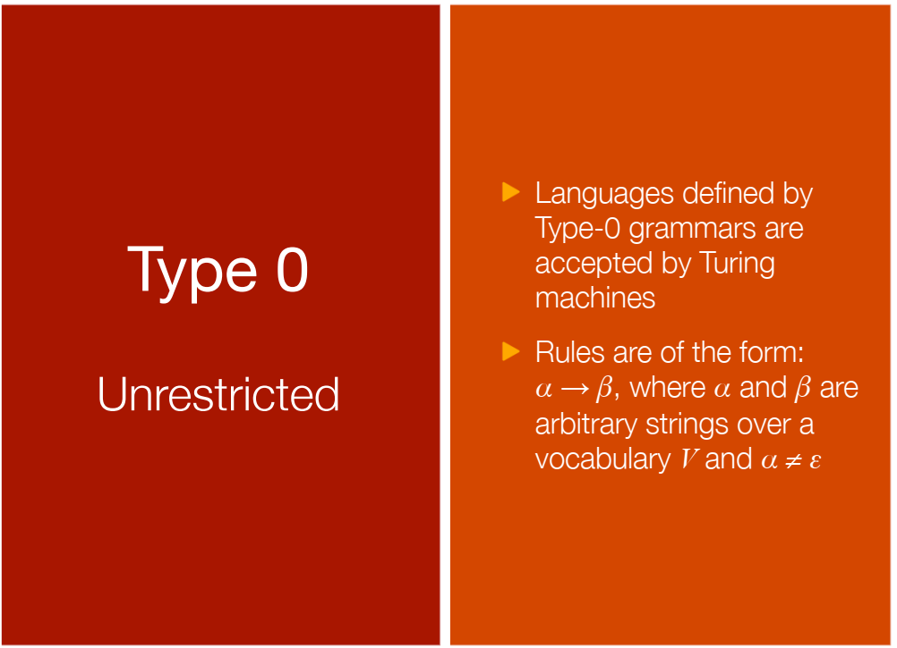

Slide 54
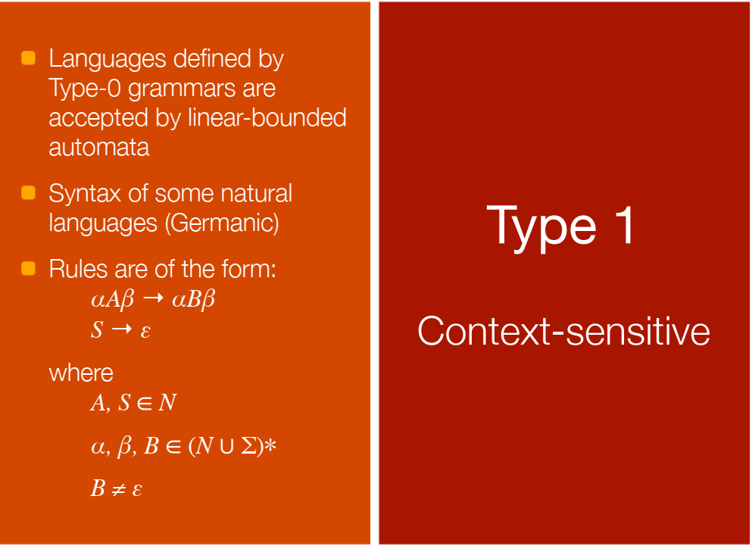

Slide 55
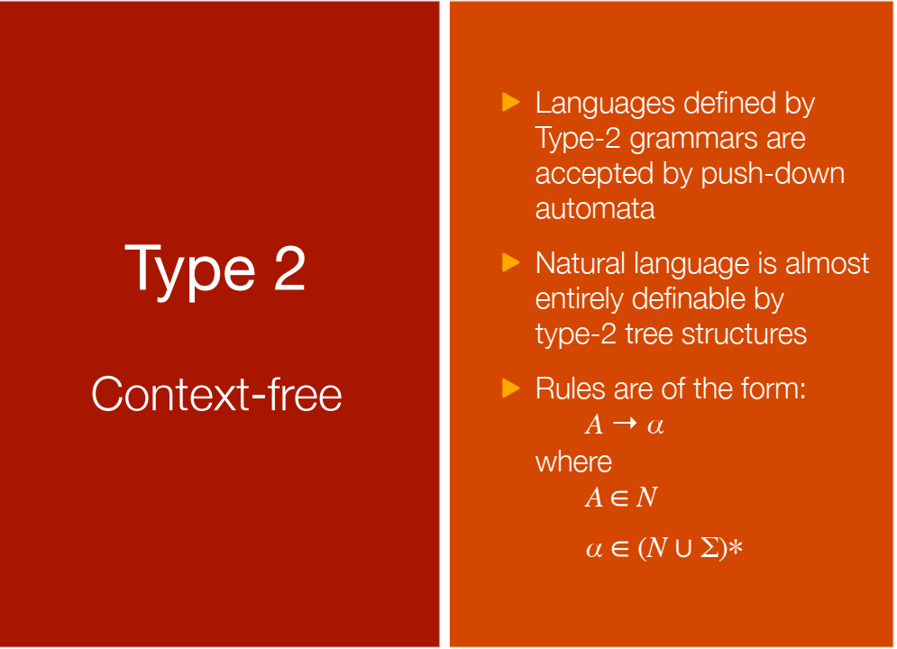

Slide 56
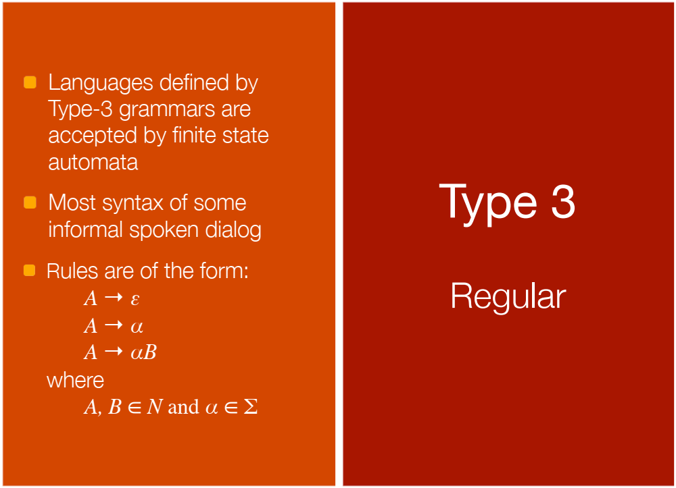

Slide 57
Chomsky's four types of grammars
Type-0 grammars (unrestricted grammars)
languages recognized by a Turing machine
Type-1 grammars (context-sensitive grammars)
Turing machine with bounded tape
Type-2 grammars (context-free grammars)
non-deterministic pushdown automaton
Type-3 grammars (regular grammars)
regular expressions, finite state automaton

Slide 58
Grammars, Languages, Machines
Type-0
Recursively enumerable Turing machine No restrictions
Type-1
Context-sensitive Linear-bounded αAβ -> αγβ
non-deterministic
Turing machine
Type-2
Context-free Non-deterministic A -> γ
pushdown automaton
Type-3
Regular Finite state automaton A -> aB
A -> a

Slide 59
The Grammar can be defined as: G=(V, ∑, p, S)
In the given definition, what does S represents?
a) Accepting State
b) Starting Variable
c) Sensitive Grammar
d) None of these

Slide 60
Which among the following cannot be accepted by a regular grammar?
a) L is a set of numbers divisible by 2
b) L is a set of binary complement
c) L is a set of string with odd number of 0
d) L is a set of 0^{n}1^{n}
Notes:
d

Slide 61
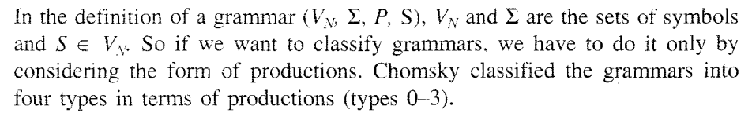
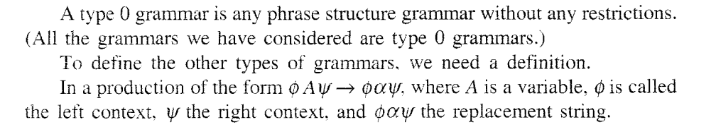

Slide 62
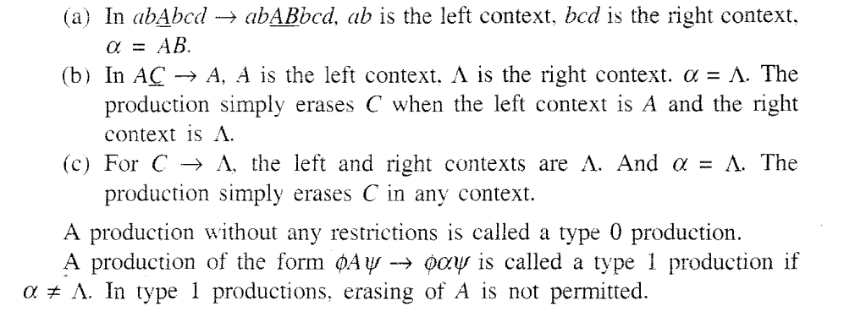

Slide 63
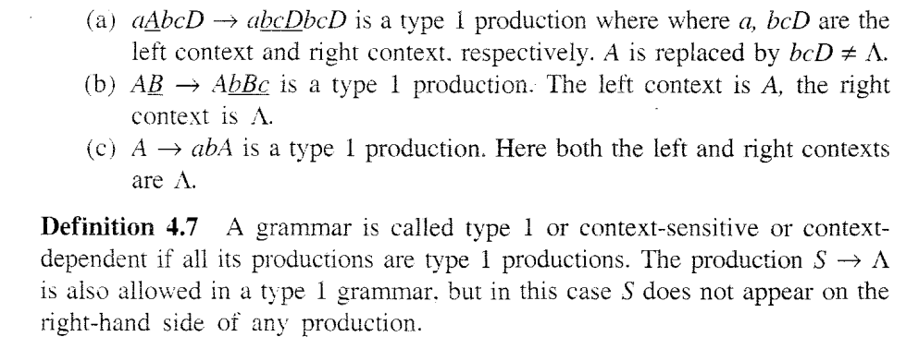
Type1

Slide 64
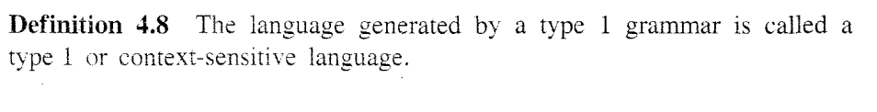
Type 1

Slide 65
Production Rule: aAb->agb belongs to which of the following category?
a) Regular Language
b) Context free Language
c) Context Sensitive Language
d) Recursively Ennumerable Language
Notes:
c

Slide 66
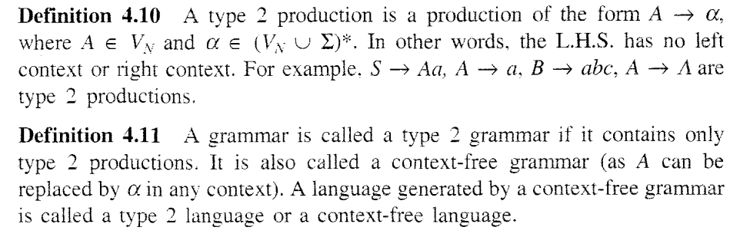
Type 2

Slide 67
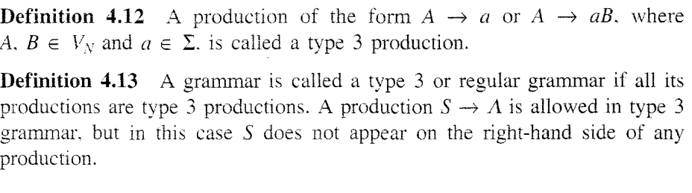
Type 3

Slide 68
. The entity which generate Language is termed as:
a) Automata
b) Tokens
c) Grammar
d) Data
Notes:
c

Slide 69
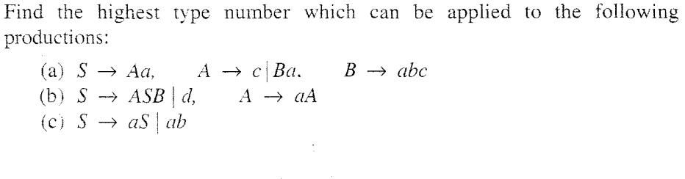
Questions

Slide 70
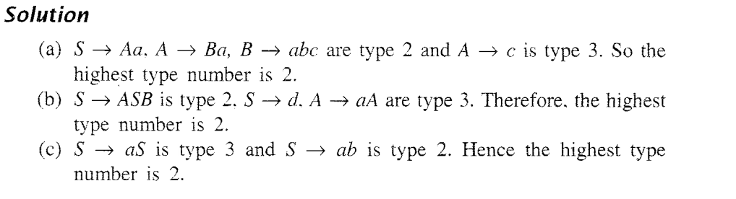
Solution

Slide 71
Let G be a grammar: S->AB|e, A->a, B->b
Is the given grammar in CNF?
a) Yes
b) No

Slide 72
With reference to the process of conversion of a context free grammar to CNF, the number of variables to be introduced for the terminals are:
S->ABa
A->aab
B->Ac
a) 3
b) 4
c) 2
d) 5

Slide 73
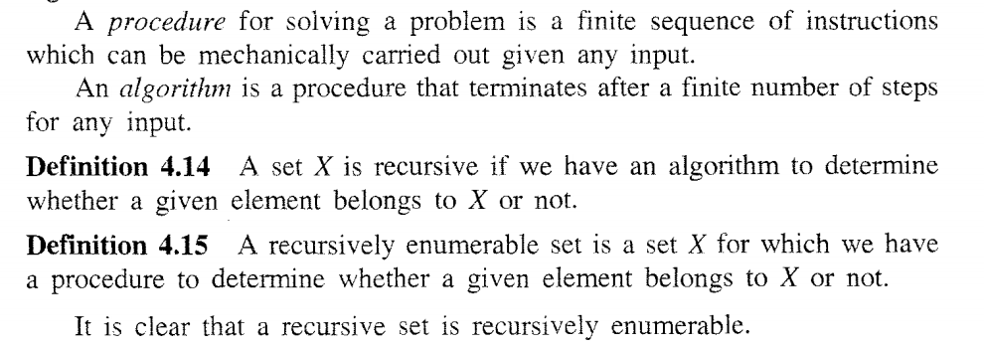
Recursive and Enumerable Sets

Slide 74
Recursive and Enumerable Sets
L is recursive enumerable if there is Turing Machine
Three states : Halt and Accepts
Halt and reject
Never halt
Closed under all except -,complement.

Slide 75
Recursive Language
L is recursive if there is halting and total turing machine
Two states : Halt and Accept
Halt and reject
Closed under all except Homorphism and substitution.

Slide 76
The Chomsky Hierarchy
Non Turing-Acceptable
Turing-Acceptable
decidable
Context-sensitive
Context-free
Regular

Slide 77
Which of the following statement is false?
a) Context free language is the subset of context sensitive language
b) Regular language is the subset of context sensitive language
c) Recursively ennumerable language is the super set of regular language
d) Context sensitive language is a subset of context free language
Notes:
d

Slide 78
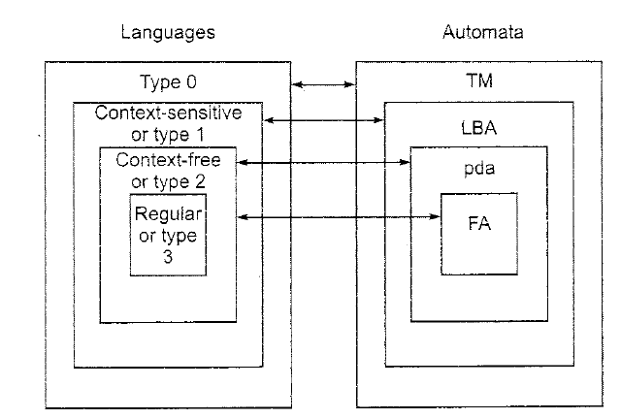
LANGUAGES AND AUTOMATON
Notes:
The Chomsky Hierarchy

Slide 79
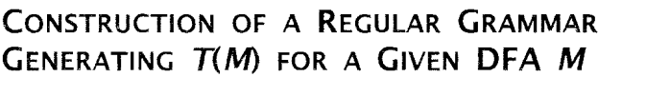
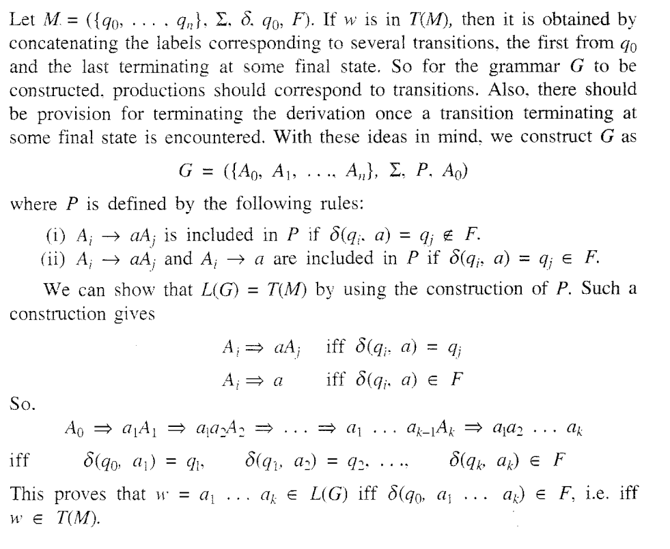

Slide 80
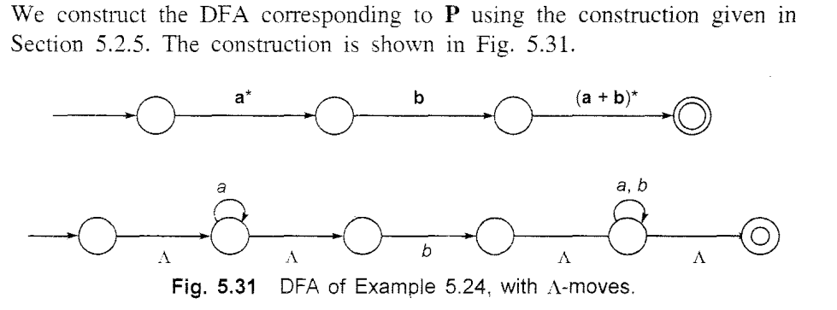

Slide 81
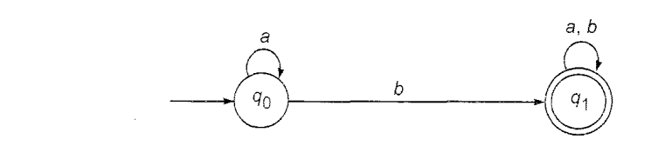
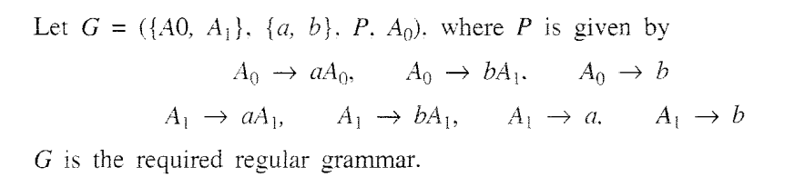

Slide 82
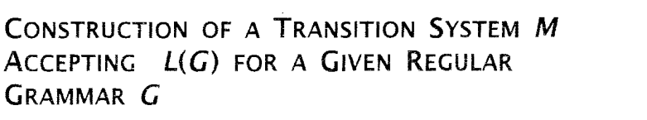


Slide 83


Slide 84


Slide 85



